Slide 1
Numerical Methods
Introduction

Slide 2
How do we solve an engineering problem?
Problem Description
Mathematical Model
Solution of Mathematical Model
Using the Solution

Slide 3
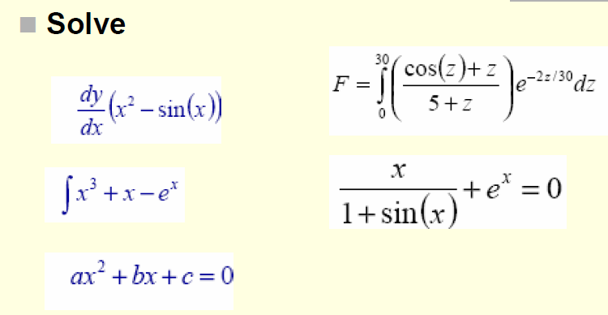
Introduction
Consider the following equations.

Slide 4
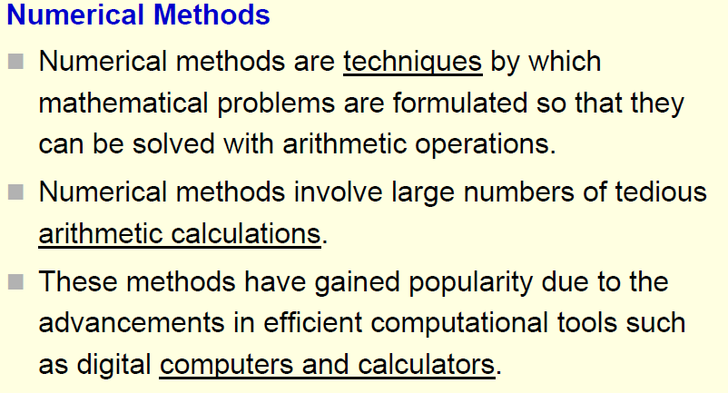
Numerical Methods - Definitions

Slide 5
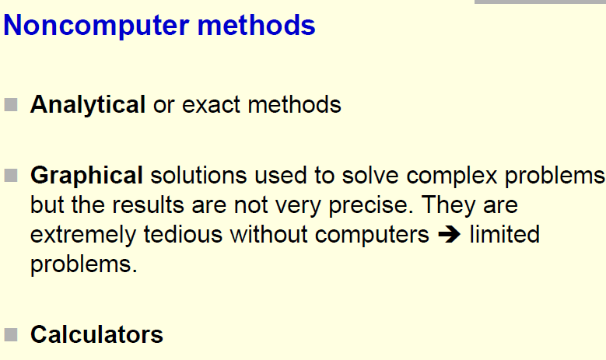
Numerical Methods

Slide 6
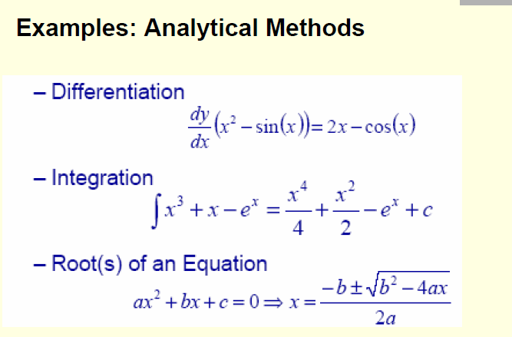
Analytical vs. Numerical methods

Slide 7
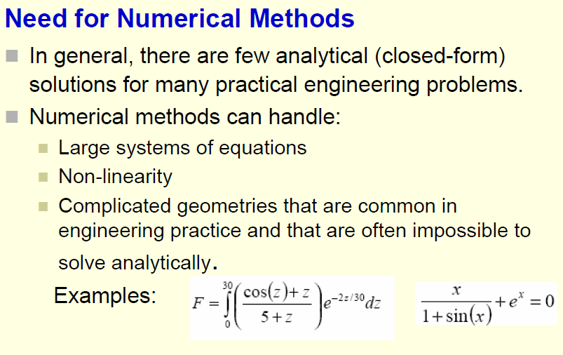
Analytical vs. Numerical methods

Slide 8
Reasons to study numerical Analysis
Powerful problem solving techniques and can be used to handle large systems of equations
It enables you to intelligently use the commercial software packages as well as designing your own algorithm.
Numerical Methods are efficient vehicles in learning to use computers
It Reinforce your understanding of mathematics; where it reduces higher mathematics to basic arithmetic operation.

Slide 9
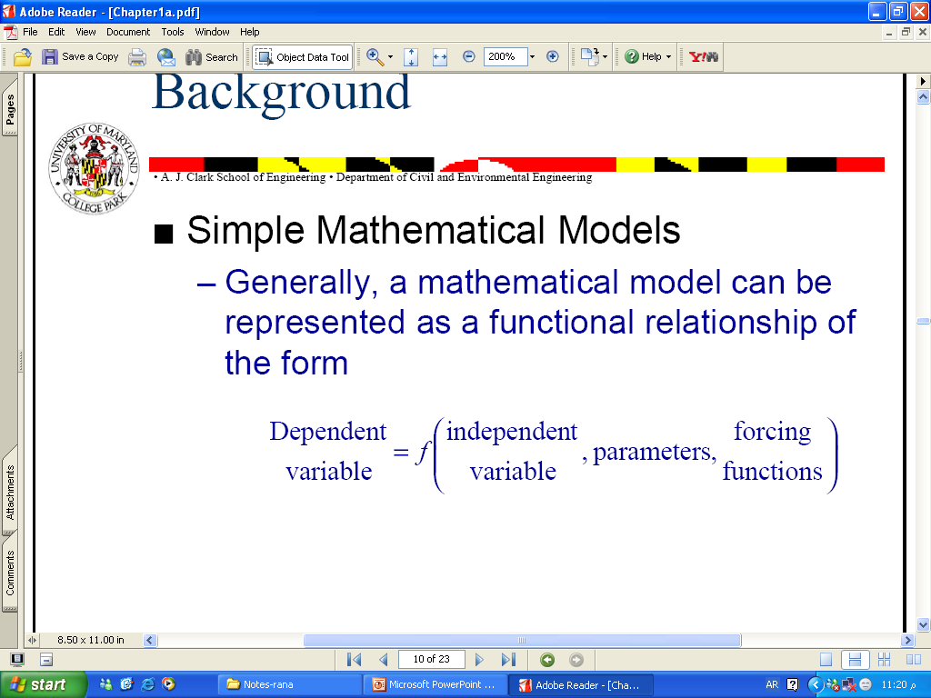
Mathematical Modeling
Mathematical Model
A formulation or equation that expresses the essential features of a physical system or process in mathematical terms.
Generally, it can be represented as a functional relationship of the form

Slide 10
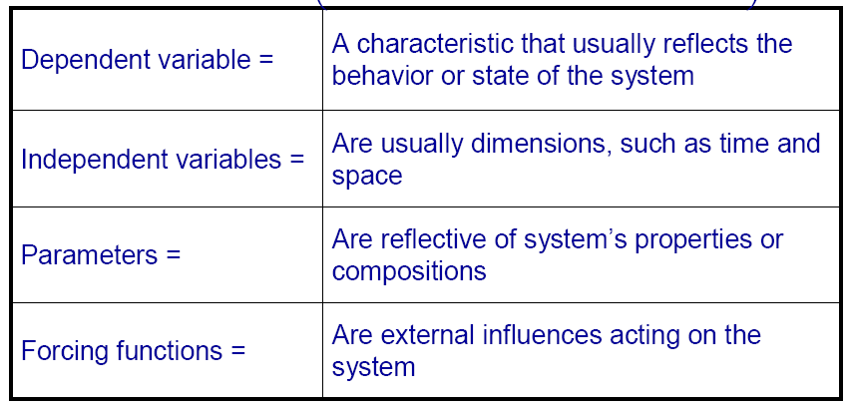
Mathematical Modeling

Slide 11
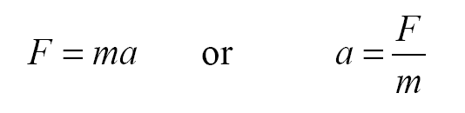
Simple Mathematical Model
Example: Newton’s Second Law
(The time rate of change of momentum of a body is equal to the resultant force acting on it)
a = acceleration (m/s²) ….the dependent variable
m = mass of the object (kg) ….the parameter representing a property of the system.
f = force acting on the body (N)

Slide 12
Typical characteristics of Math. model
It describes a natural process or system in mathematical way
It represents the idealization and simplification of reality.
It yields reproducible results, and can be used for predictive purpose.

Slide 13
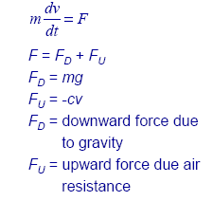
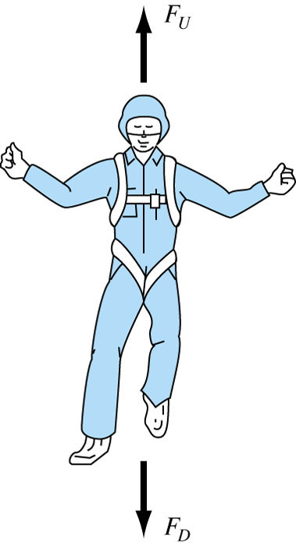
Complex Mathematical Model
Example: Newton’s Second Law
Where:
c = drag coefficient (kg/s),
v = falling velocity (m/s)

Slide 14
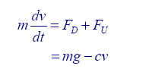
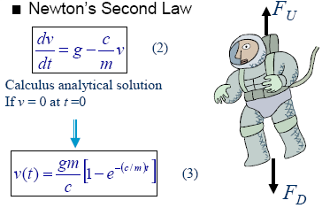
Complex Mathematical Model
At rest: (v = 0 at t = 0),
Calculus can be used to solve the equation

Slide 15
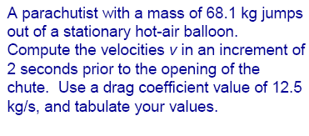
Analytical solution to Newton's Second Law
.

Slide 16
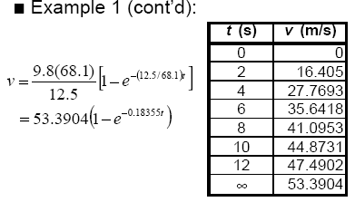
Analytical solution to Newton's Second Law

Slide 17
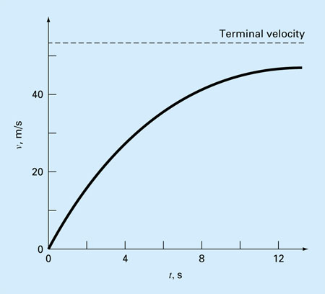
Analytical solution to Newton's Second Law

Slide 18
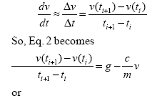
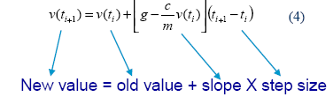
Numerical Solution to Newton's Second Law
Numerical solution: approximates the exact solution by arithmetic operations.
Suppose
➔

Slide 19
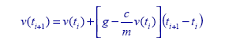
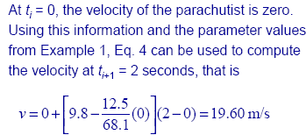
Numerical Solution to Newton's Second Law
.

Slide 20
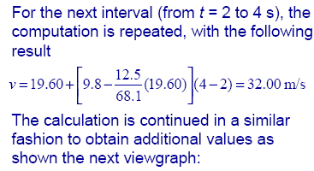
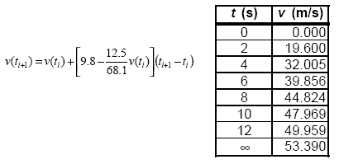
Numerical Solution to Newton's Second Law
.

Slide 21
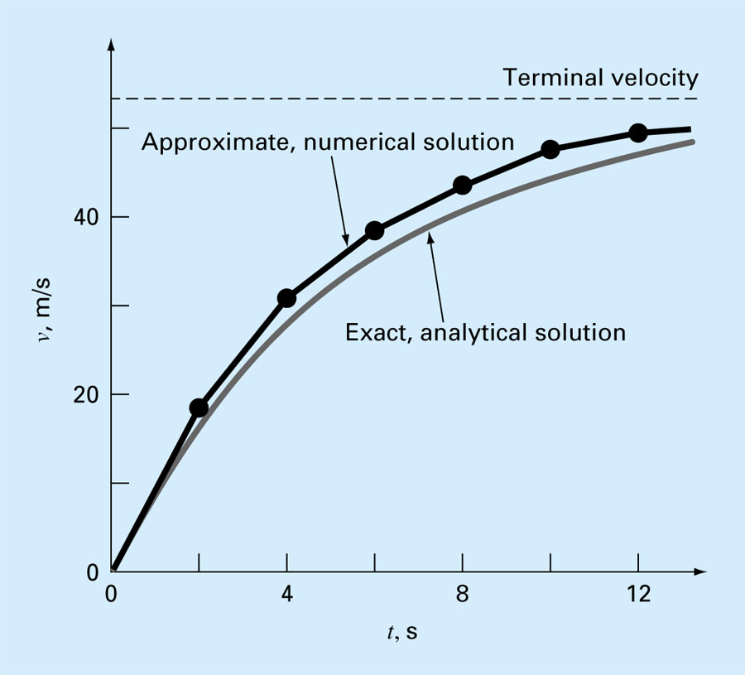
Comparison between Analytical vs. Numerical Solution

